Slide 1
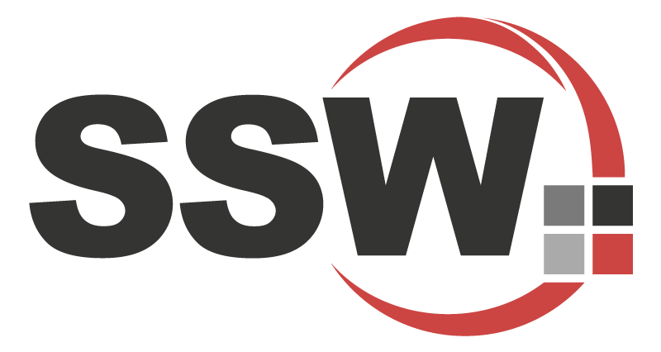
Enterprise Software Development

Slide 2
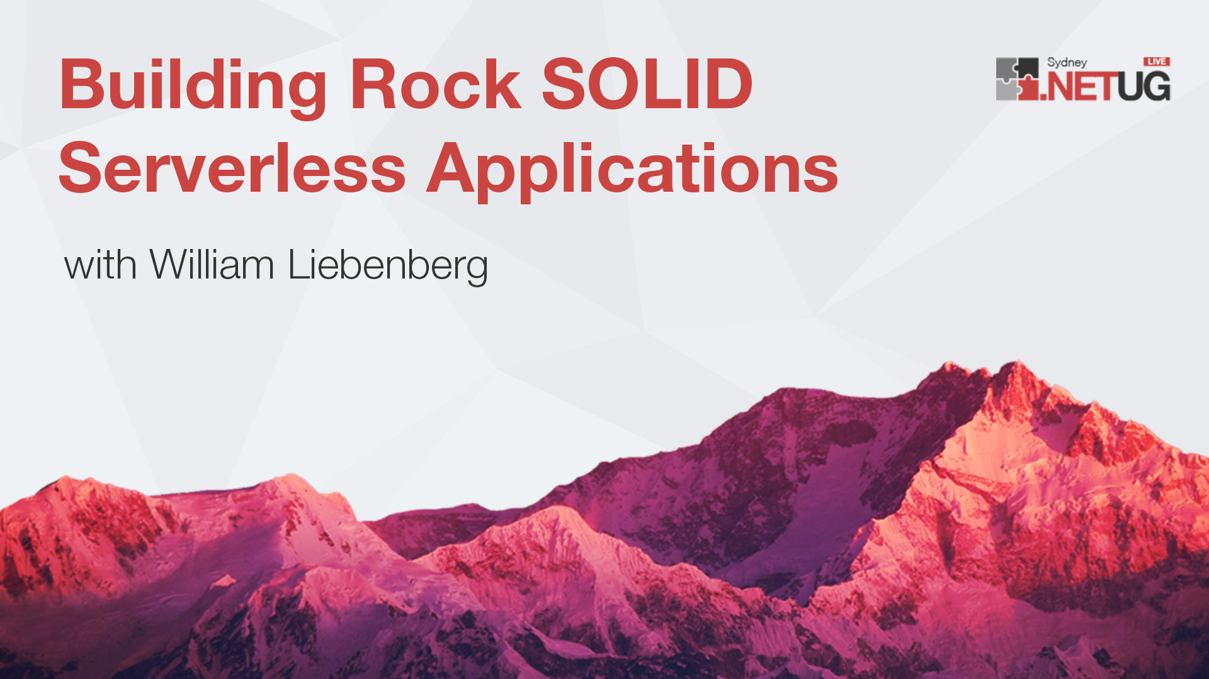
.NET User Group 2021

Slide 3
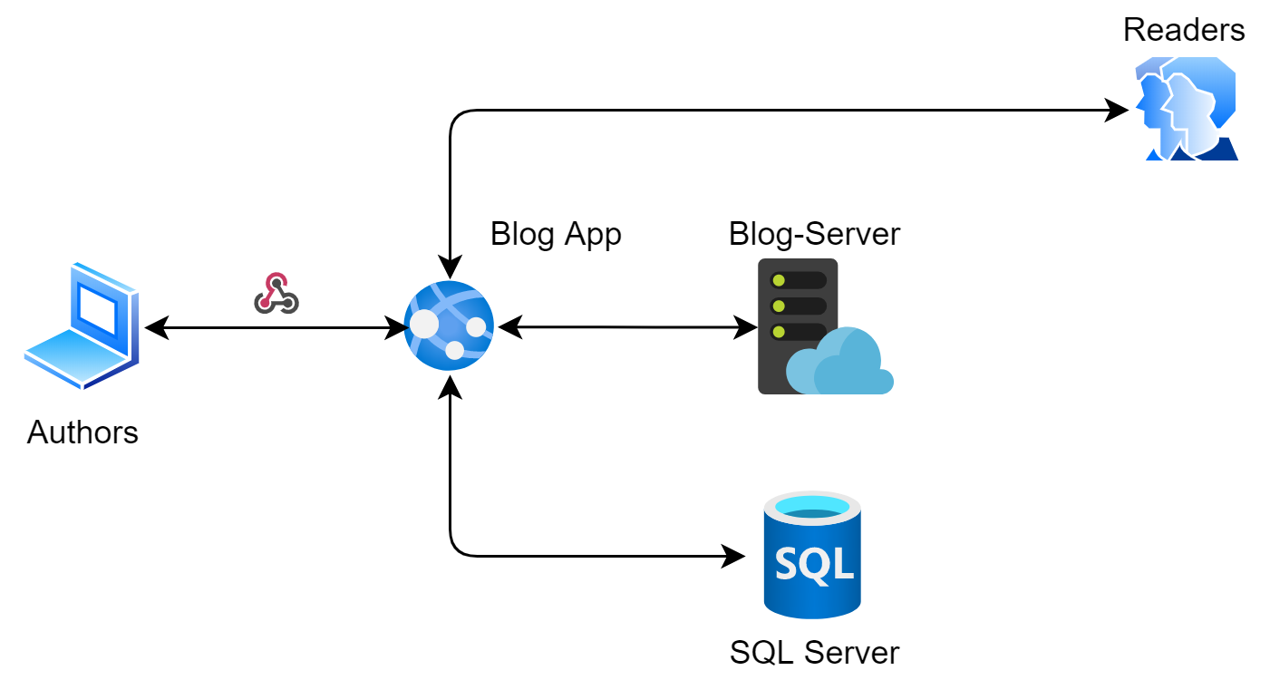
A simple app - Classic
Notes:
Very scaled down version of the full picture … <still a few pieces missing> to complete a whole blog engine…
Just to show the event flow… for now

Slide 4



A simple app - Classic
Notes:
Very scaled down version of the full picture … <still a few pieces missing> to complete a whole blog engine…
Just to show the event flow… for now

Slide 5
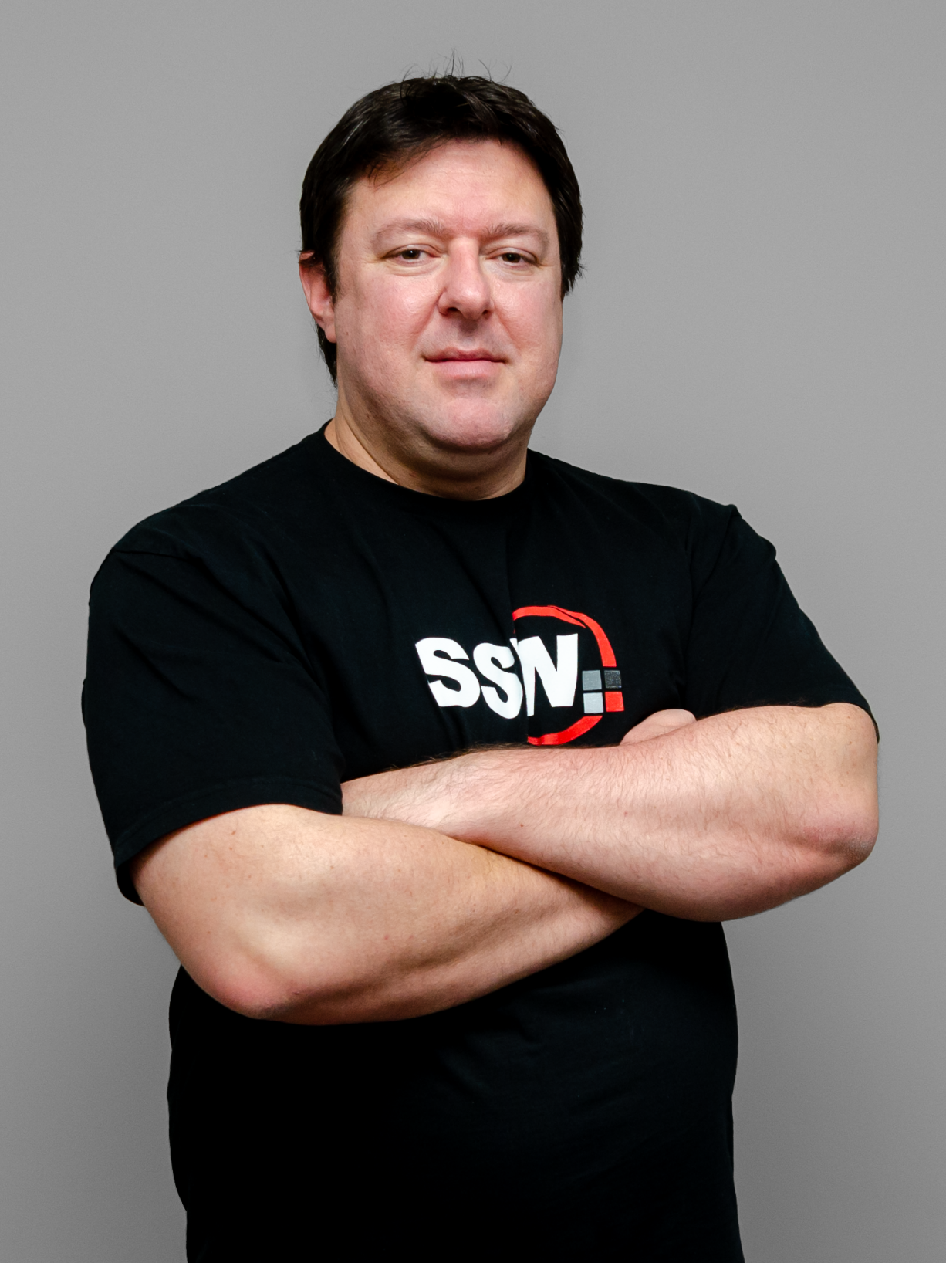
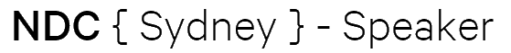
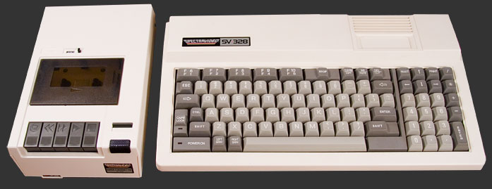
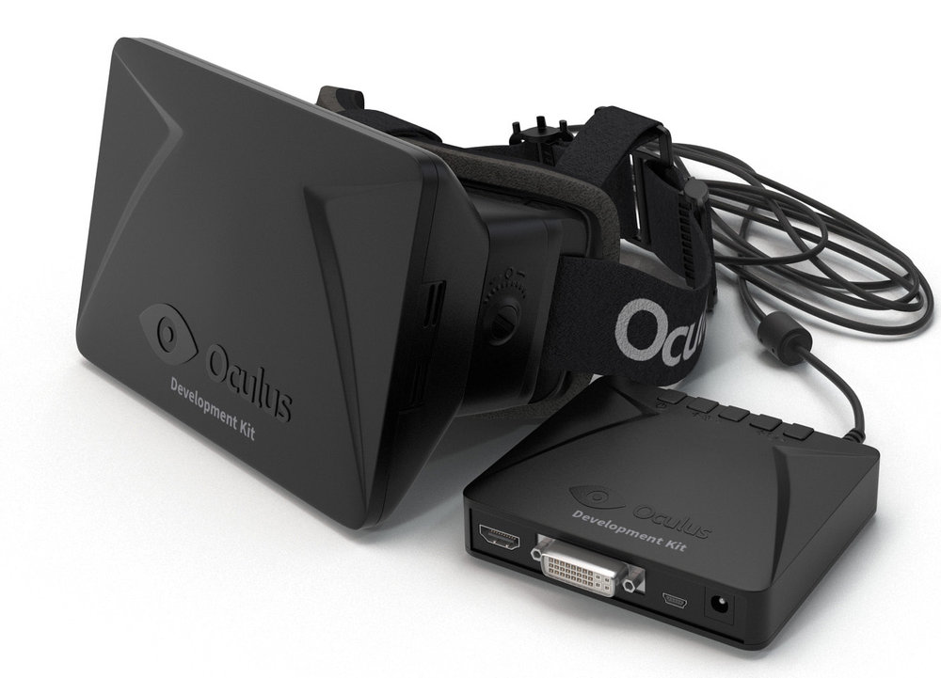
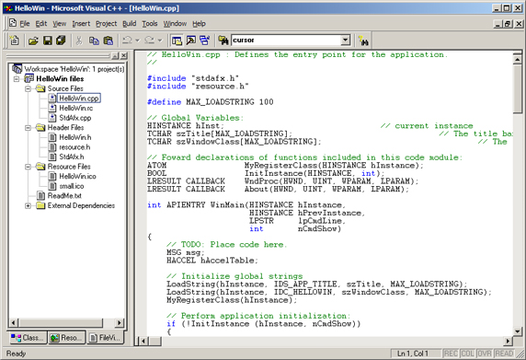

William Liebenberg
Solution Architect at SSW
@William_DotNet
https://azuregems.io
william-liebenberg
First program when I was 5 years old using BASIC on a Spectra Video 328
Developing professionally since 2004
.NET v2.0 since 2006
3D Industrial Training Simulations + VR
Enterprise Azure since 2014
Notes:
My intro: more about azure

Slide 6


Agenda
Clean Code & SOLID
SOLID & Serverless
Resiliency
Scalability
Wrap Up!
Notes:
Photo by Artem Kniaz on Unsplash
Photo by John Thoresen on Unsplash

Slide 7
Agenda
Clean Code & SOLID
SOLID & Serverless
Resiliency
Scalability
Wrap Up!
Notes:
Photo by Artem Kniaz on Unsplash
Photo by John Thoresen on Unsplash

Slide 8
Why Clean Code?
Notes:
Introduce code that is easy to understand and maintain
TODO: Insert serious measurement (dependency graphs… etc. ) for measuring code quality

Slide 9
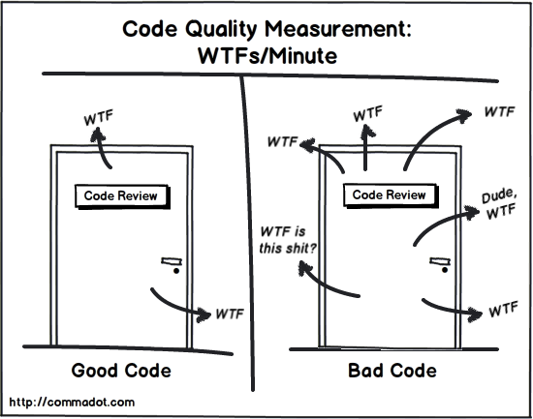

Slide 10
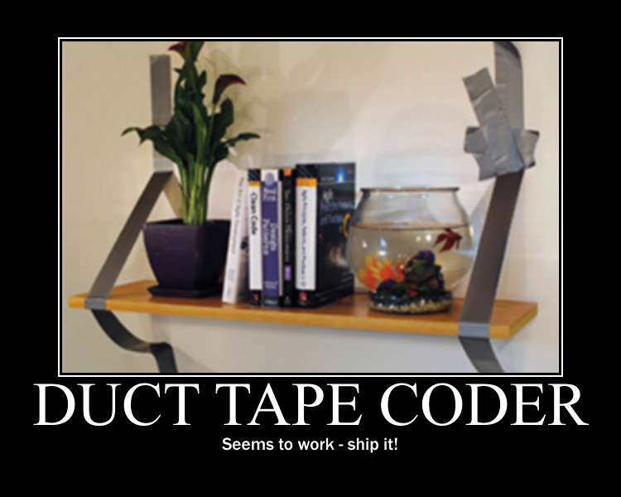
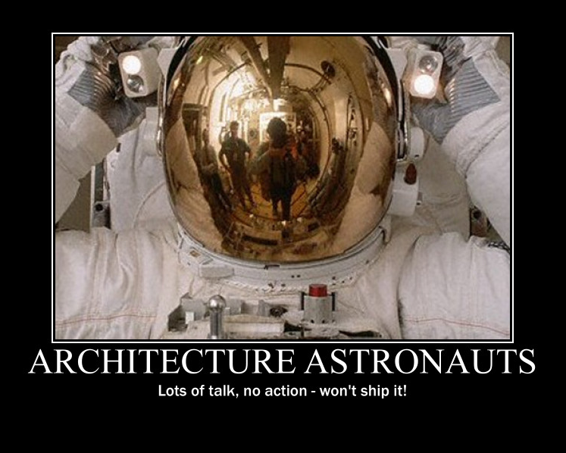
Notes:
My goal is to find Simple solutions to complex problems that will withstand the test of time. I want to write software that is easy to maintain and easy to understand.
IDEA: Possibly swap with first Why Clean Code
Introduce the two coders separately –

Slide 11
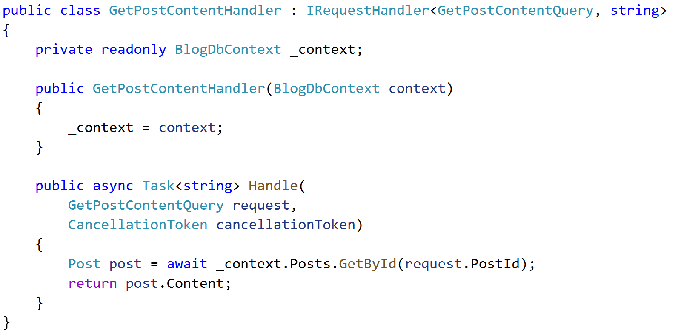
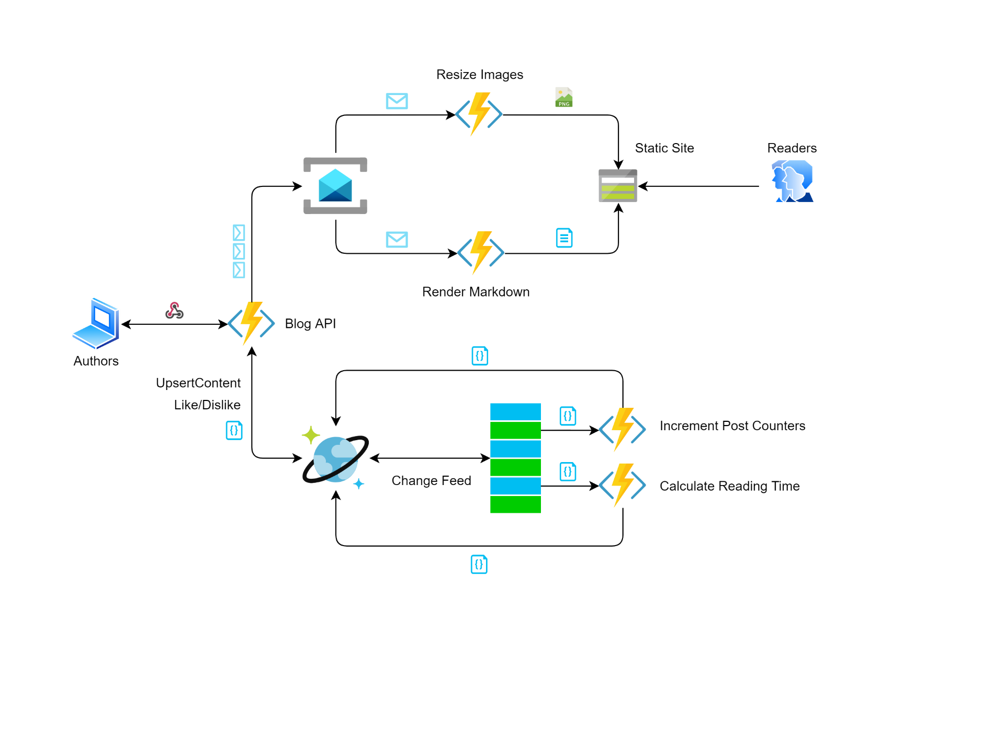
Notes:
My goal is to find Simple solutions to complex problems that will withstand the test of time. I want to write software that is easy to maintain and easy to understand.
IDEA: Possibly swap with first Why Clean Code
Introduce the two coders separately –

Slide 12
Clean Code
Easy to Understand
Execution flow
Class interactions
Purpose of Class
Purpose of Functions & Variables
Easy to Change
Classes and methods are small and only have single responsibility
Classes have clear public interface
Classes and methods are predictable, work as expected
Code is testable and has unit tests
Easy to write the tests
Notes:
Easy to understand means the code is easy to read, whether that reader is the original author of the code or somebody else.
Easy to change means the code is easy to extend and refactor, and it’s easy to fix bugs in the codebase.

Slide 13
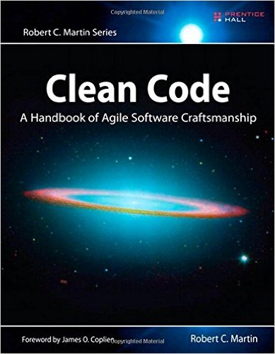
Clean Code
SRP – Single Responsibility Principle
OCP – Open/Closed Principle
LSP – Liskov Substitution Principle
ISP – Interface Segregation Principle
DIP – Dependency Inversion Principle
Notes:
Clean code also covers the solid principles. Its hard to explicitly follow these principles….
Follow uncle bob;s clean code book
TODO: Mention that we will be referring back to these principles during the talk… so check out the book for further understanding.
SRP – Class should have only on job, and only one reason to change. Bad example, class that uploads a file and prints a file.
OCP – Be able to expand a class’s behavior without modifying it.
Bad example, Area calculation of Rectangles and Circles.. The area calculator needs to be modified when we add Triangle.
Good Example, use a base class Shape, inherit Rect/Circle/Triangle and pass the shapes into Area Calculator.
LSP – If a class or module uses a base class, it should be replaceable with a derived class without changing the functionality. Example…
ISP – Interfaces that are specific to the functionality it needs to provide. Don’t add methods to interfaces that wont be used. Or…. Try to keep interfaces small and even follow SRP.
DIP – Depend on abstractions, not on concrete implementations – always code towards the interface. High level classes should not depend on low level classes.

Slide 14
Clean Architecture
Domain
Enterprise logic and types
class Customer { … }
class Invoice {
bool IsOutstanding() { … }
}
Domain

Slide 15
Clean Architecture
Application
Business Logic and Types
interface INotificationService { … }
GetCustomers() {…}
GetUnpaidInvoices() {…}
Application
Domain

Slide 16
Clean Architecture
Infrastructure
Persistence
Infrastructure
Implementations of Application interfaces
class EmailService : INotificationService { … }
class PdfRenderer : IDocumentRenderer { … }
Persistence
Implementations of Data Persistence interfaces
class Repository : IRepository { … }
class MyDbContext : IDbContext { … }
Application
Domain

Slide 17
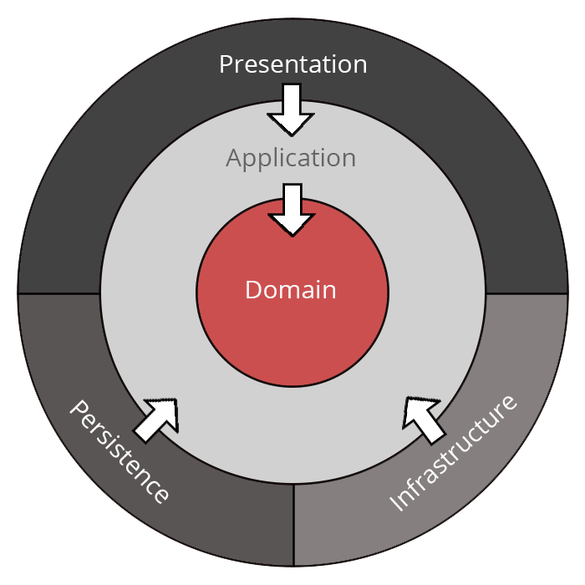
Clean Architecture
Infrastructure
Persistence
Presentation
Presentation
Console, WebAPI, Azure Function
Entry point / Translation layer
HttpRequest → GetUnpaidInvoicesDto
Composition Root / DI Container Builder
Application
Domain

Slide 18
Clean Architecture
Infrastructure
Persistence
Presentation
Presentation
Console, WebAPI, Azure Function
Entry point / Translation layer
HttpRequest → GetUnpaidInvoicesDto
Composition Root / DI Container Builder
Application
Domain

Slide 19
Clean Architecture
Infrastructure
Persistence
Presentation
Benefits
Dependencies Point Inwards
Core is Framework Independent
Independent of UI
Testable
Application
Domain

Slide 21
Clean Architecture
Infrastructure
Persistence
Presentation
Independent of Frameworks
Testable
Independent of UI
Independent of the Database
Independent of anything External
Dependencies Point Inwards
Application
Domain
Notes:
Clean Arch shows you how to structure your solution to withstand the test of time.
There are 3 layers, but you may need more or less. Just make sure that the dependencies point inwards.

Slide 22
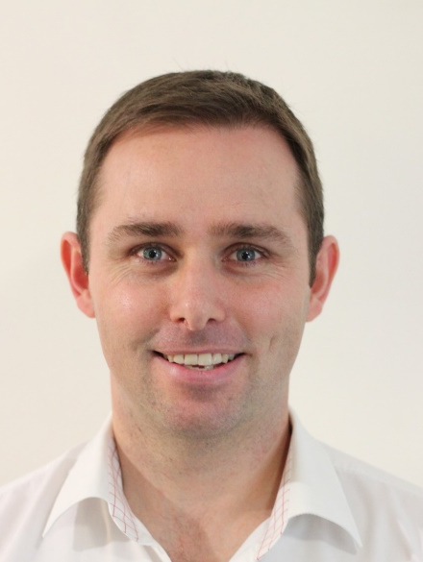
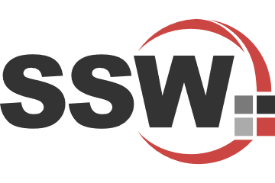
Clean Architecture - Resources
Jason Taylor - bit.ly/ca-sln
bit.ly/RulesToCleanArchitecture

Slide 23
CQRS / MediatR
Command Query Responsibility Segregation
IRequest and IRequestHandler
Behaviour Pipeline for cross-cutting concerns
Notes:
Show simple MediatR Request and RequestHandler code first
Then move onto the IQuery and ICommand specialisations -=- with modified slide
With CQRS use MediatR –
Commands and Queries are Requests
Powerful request pipeline
Becomes trivial to add logging + validation + caching
Mention publishing pipeline for publishing events

Slide 24
MediatR Behaviour Pipelines
Logging
Authentication/Authorization
Validation with Fluent Validation
Exception Handling

Slide 25
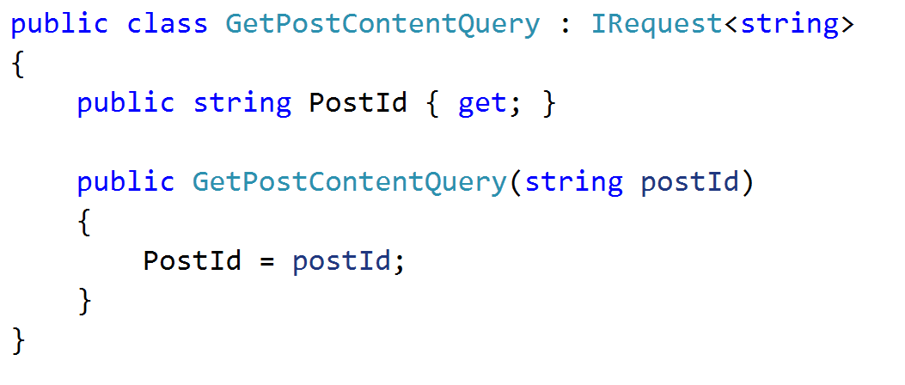
IRequest

Slide 26
IRequestHandler

Slide 27
MediatR Enhancement
public interface ICommand<out TResult> : IRequest<TResult> { }
public interface ICommandHandler<in TCommand, TResult> :
IRequestHandler<TCommand, TResult> where TCommand : IRequest<TResult>
{ }
public interface IQuery<out TResult> : IRequest<TResult> { }
public interface IQueryHandler<in TQuery, TResult> :
IRequestHandler<TQuery, TResult> where TQuery : IRequest<TResult>
{ }

Slide 28


How does Clean Code & SOLID apply to Serverless applications?

Slide 29
Clean Code & SOLID
SOLID & Serverless
Agenda
Resiliency
Scalability
Wrap Up!
Notes:
Photo by Artem Kniaz on Unsplash
Photo by John Thoresen on Unsplash

Slide 30
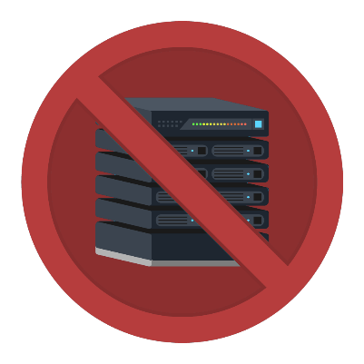
Why Serverless?
Server goes down – you won’t notice it
Spend Less $$
Notes:
DevOps: Deploy function apps separately + low coupling allows better testing
Scaling is something serverless excels at, but it also has some limits.
Serverless is a perfect compute model for event-based processing. Most workloads on the web are event-based or can be converted to it. Think DDD
As long as your workload can be event-driven and processing an event is relatively quick with low resource requirements, serverless should work well for you.
When your applications scale well, they will provide better value for you and your users. You’ll run them cheaper. Serverless helps by eliminating overprovisioning and overpaying for compute resources you don’t utilize.
While serverless improves scaling, other billable utilization still applies—you should still think about how much bandwidth, storage, and database volume you use.
Serverless will not help you better utilize those resources at the moment, that’s still up to you and your application.

Slide 31
Why Serverless?
Simplified programming model - just your code
Simplified DevOps
Consumption billing - Eliminate Over/Under provisioning
Event driven scaling
Low-coupling allows for better testing
Notes:
DevOps: Deploy function apps separately + low coupling allows better testing...
Scaling is something serverless excels at, but it also has some limits.
Serverless is a perfect compute model for event-based processing. Most workloads on the web are event-based or can be converted to it. Think DDD
As long as your workload can be event-driven and processing an event is relatively quick with low resource requirements, serverless should work well for you.
When your applications scale well, they will provide better value for you and your users. You’ll run them cheaper. Serverless helps by eliminating overprovisioning and overpaying for compute resources you don’t utilize.
While serverless improves scaling, other billable utilization still applies—you should still think about how much bandwidth, storage, and database volume you use.
Serverless will not help you better utilize those resources at the moment, that’s still up to you and your application.

Slide 32

Serverless Architecture
SRP – Single Responsibility Principle:
Group a set of functions related to one concern
Resiliency:
Decouple functions using Queue or Service Bus messages
Distributed workload:
Functions apps can scale independently
DevOps:
Deploy function apps separately + low coupling allows better testing
Notes:
DevOps: Deploy function apps separately + low coupling allows better testing

Slide 33
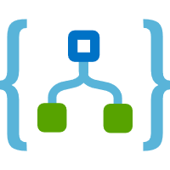







Azure - Serverless Services
Compute
Data
Messaging
Notes:
COMPUTE:
Azure Functions – event driven compute… scale on demand, micro billing/consumption…
Serverless Kubernetes - start containers in seconds using AKS Virtual Nodes… via Virtual Kubelets… and then harness KEDA for event driven autoscaling your cluster
DATA:
SQL Serverless – set min and max cores so you can scale based on the demand… goes to sleep and you don’t pay anything
CosmosDB – globally distributed, elastic scale, multi-model, real-time triggers – omg it’s the best!
MESSAGING:
Azure Service Bus (transactions, guaranteed delivery)
Eventhub (streaming)
Eventgrid (infra event’s)
Should add SignalR Service
Can connect serverless logic to events occurring from various azure services (and external – using CloudEvents)…. So that we can build highly distributed and scalable cloud solutions.

Slide 34
My Serverless Services
Functions
CosmosDB
ServiceBus
Elastic scale
Run-anywhere (FaaS, Docker, OnPrem)
NoSQL (write data as-is)
Elastic scale
Change Notification
Guaranteed delivery
Queues or Topics with Subscriptions & Filters
Notes:
COMPUTE:
Azure Functions – event driven compute… scale on demand, micro billing/consumption…
Serverless Kubernetes - start containers in seconds using AKS Virtual Nodes… via Virtual Kubelets… and then harness KEDA for event driven autoscaling your cluster
FaaS + Static Sites go hand-in-hand…
DATA:
SQL Serverless – set min and max cores so you can scale based on the demand… goes to sleep and you don’t pay anything
CosmosDB – globally distributed, elastic scale, multi-model, real-time triggers – omg it’s the best!
MESSAGING:
Azure Service Bus (transactions, guaranteed delivery)
Eventhub (streaming)
Eventgrid (infra event’s)
Can connect serverless logic to events occurring from various azure services (and external – using CloudEvents)…. So that we can build highly distributed and scalable cloud solutions.

Slide 35
A simple app - Classic
Notes:
Very scaled down version of the full picture … <still a few pieces missing> to complete a whole blog engine…
Just to show the event flow… for now

Slide 36
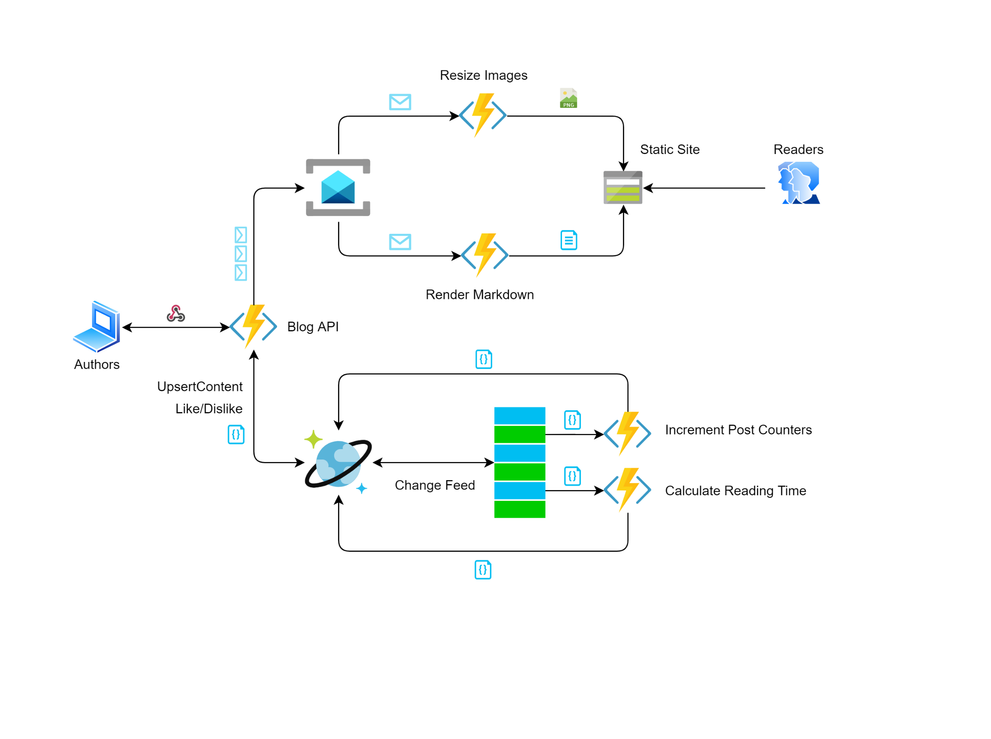
A Serverless app
Notes:
Very scaled down version of the full picture … <still a few pieces missing> to complete a whole blog engine…
Just to show the event flow… for now
Using SB for knowing exactly which image blobs to resize…
While working on the blog post, images are uploaded straight to the draft content folder, no need to resize / generate thumbnails etc. and store in storage

Slide 37
I’M SOLD!

Slide 38
How does SOLID apply to Serverless applications?

Slide 39
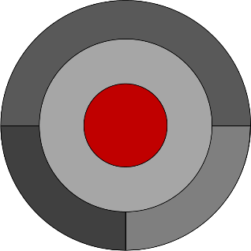
Clean Code Principles
SRP – Single Responsibility Principle
Only one reason to change
Notes:
SRP – Class should have only on job, and only one reason to change. Bad example, class that uploads a file and prints a file.
For me, SRP and ISP go hand-in-hand … don’t add functionality that isn’t needed… just have an interface for what is needed… if you need different functionality then it is a different function app

Slide 40
A Serverless app + SRP
Notes:
SRP – Single Responsibility
Only one reason to change…
Bad example: Resizeing Images and Rendering Markdown, and calculating reading time…
Good example: split into separate apps, each with their own responsibility
In terms of system design, the benefits are that Resize Images, can scale independently from all the other apps… if it breaks… it doesn’t affect the other apps.

Slide 41
Clean Code Principles
OCP – Open/Closed Principle
Open for extension, Closed for modification
LSP – Liskov Substitution Principle
Substitute implementation with same functionality
Notes:
OCP – Be able to expand a class’s behavior without modifying it.
Bad example, Area calculation of Rectangles and Circles.. The area calculator needs to be modified when we add Triangle.
Good Example, use a base class Shape, inherit Rect/Circle/Triangle and pass the shapes into Area Calculator.
LSP – If a class or module uses a base class, it should be replaceable with a derived class without changing the functionality. Example…

Slide 42
Clean Code Principles
LSP – Liskov Substitution Principle
Substitute implementation with same functionality
Notes:
LSP – If a class or module uses a base class, it should be replaceable with a derived class without changing the functionality. Example…

Slide 43
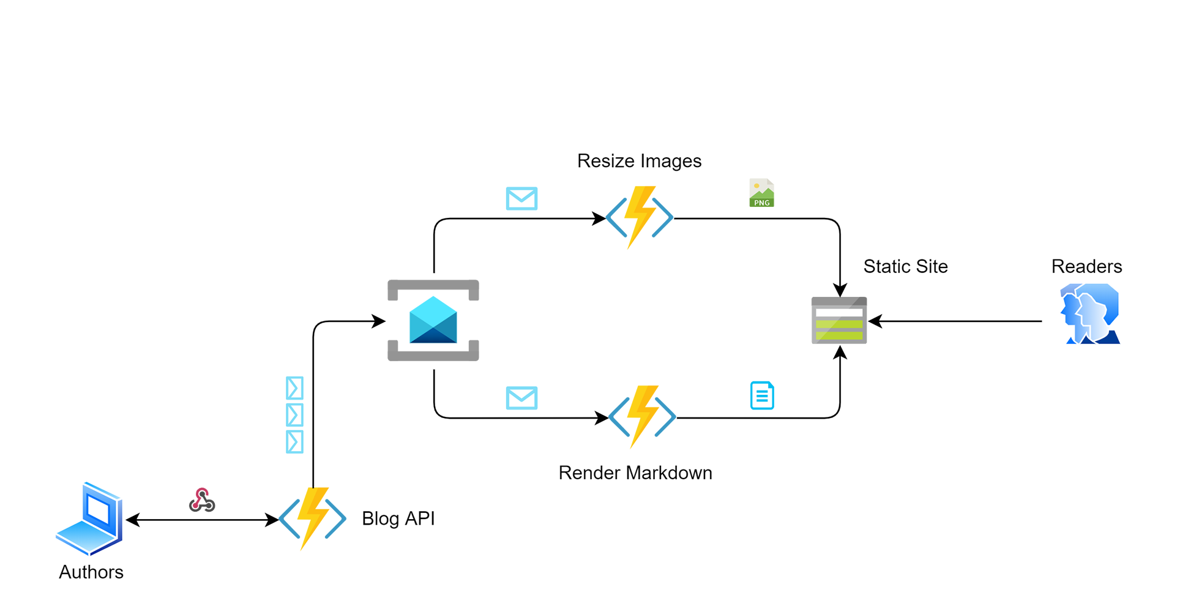
A Serverless app + OCP & LSP
Notes:
OCP – Open for extension, closed for modification…
Blue/Green deployments…
Asynchronous Integration… migration….

Slide 44
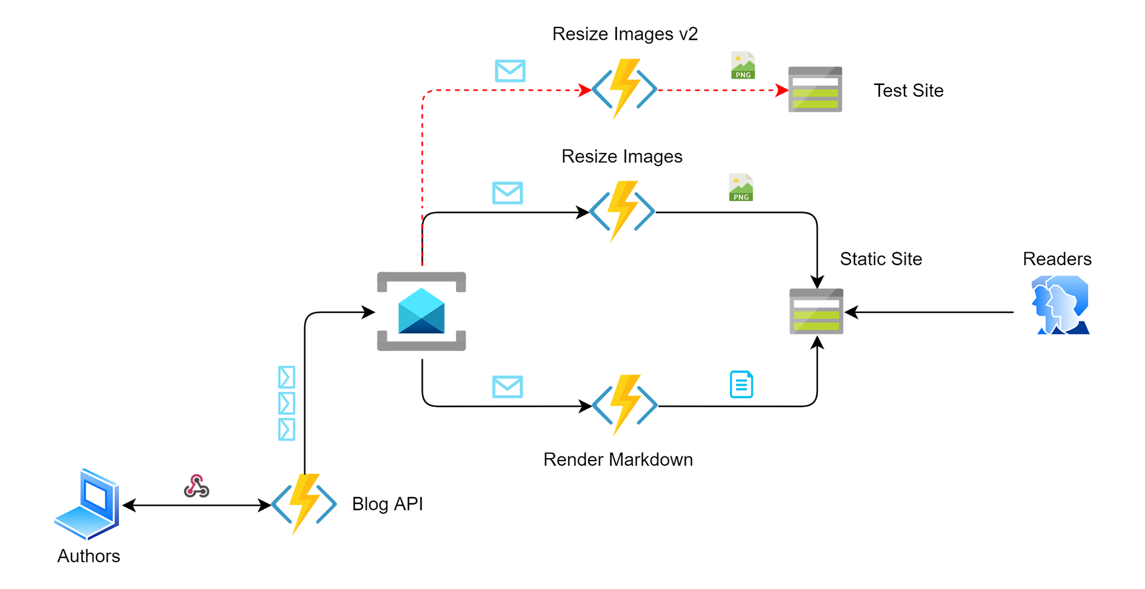

A Serverless app + OCP & LSP
Notes:
OCP – Open for extension, closed for modification…
Blue/Green deployments…
Asynchronous Integration… migration….

Slide 45
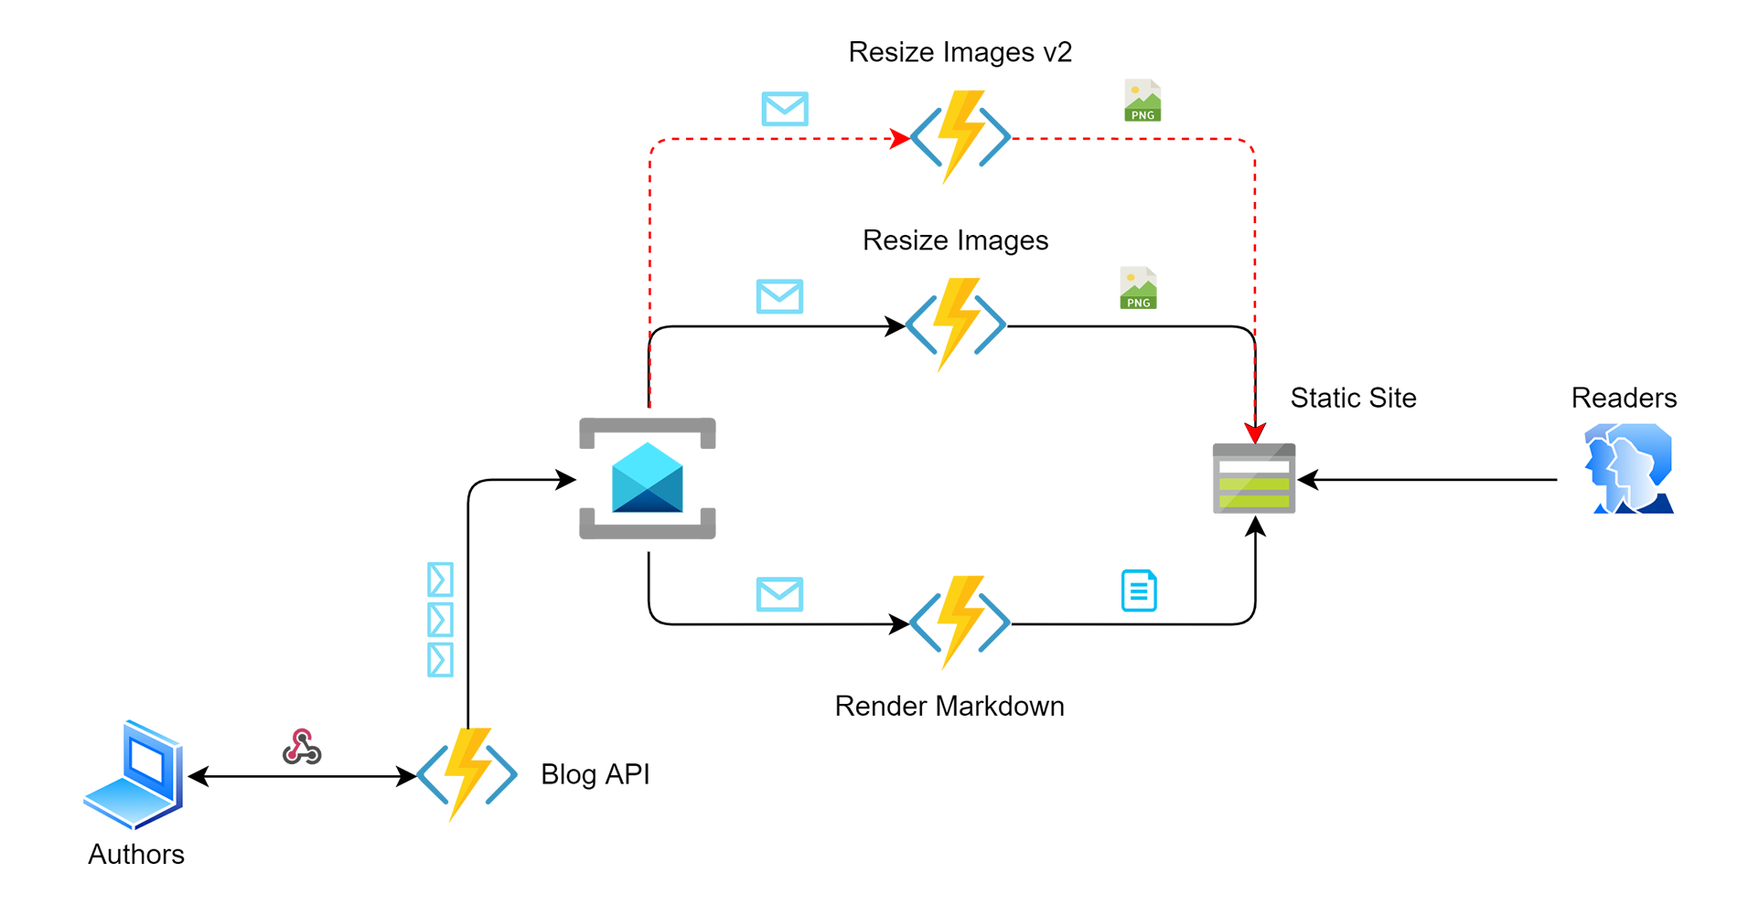
A Serverless app + OCP & LSP
Notes:
OCP – Open for extension, closed for modification…
Blue/Green deployments…
Asynchronous Integration… migration….

Slide 46
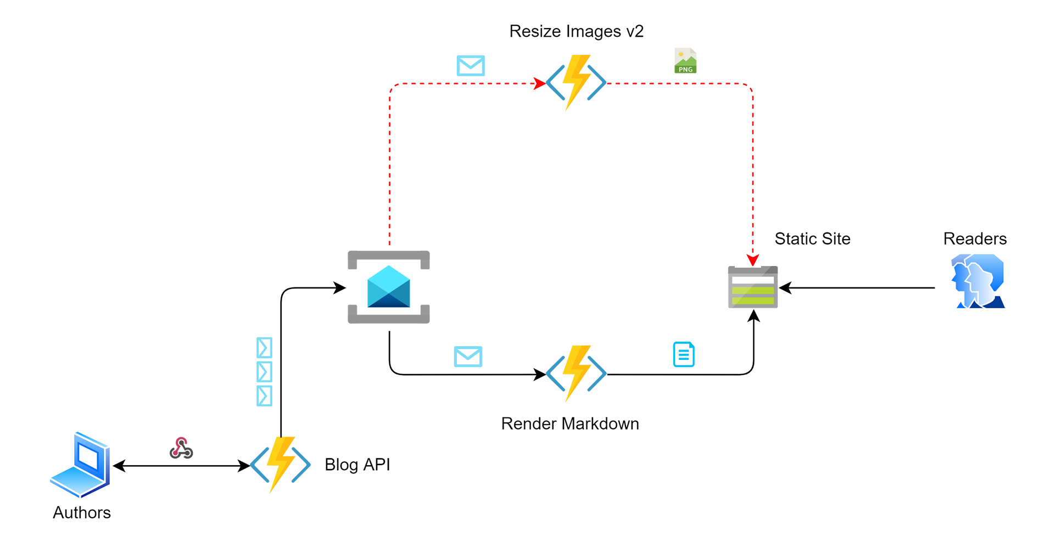
A Serverless app + OCP & LSP
Notes:
OCP – Open for extension, closed for modification…
Blue/Green deployments…
Asynchronous Integration… migration….

Slide 47
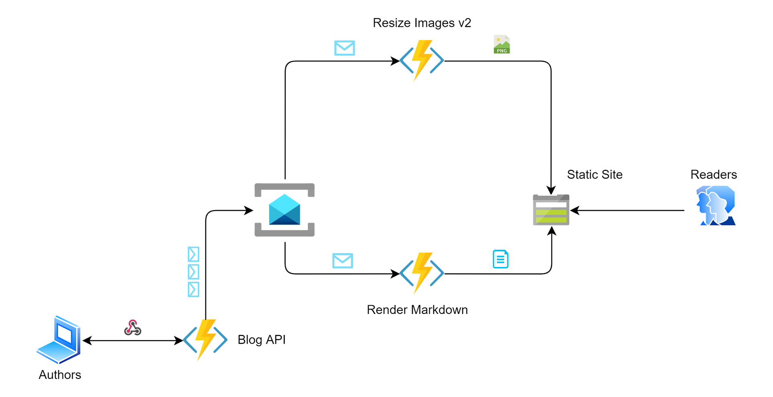
A Serverless app + OCP & LSP
Notes:
OCP – Open for extension, closed for modification…
Blue/Green deployments…
Asynchronous Integration… migration….

Slide 48
Clean Code Principles
ISP – Interface Segregation Principle
Only add functionality endpoints that will be used
Notes:
ISP – Interfaces that are specific to the functionality it needs to provide. Don’t add methods to interfaces that wont be used. Or…. Try to keep interfaces small and even follow SRP.

Slide 49
A simple app - Serverless + ISP
Split larger interfaces into separate smaller interfaces
Remove/deprecate unnecessary endpoints
Less dependencies (Smaller binaries)
Improves cold-start & scale-out times

Slide 50
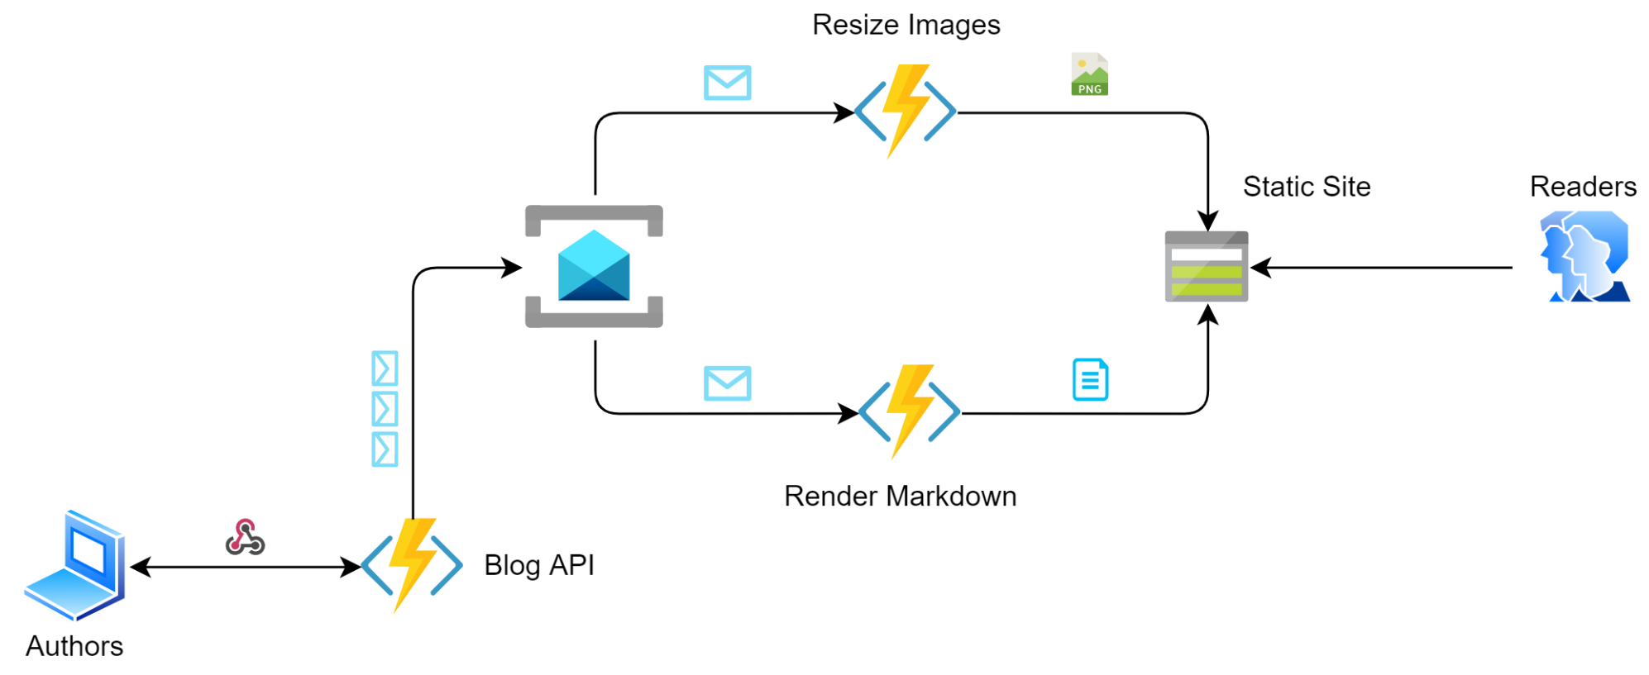
A Serverless app + ISP
Notes:
ISP – smaller apps, scales faster
We will talk about scaling a bit later

Slide 51
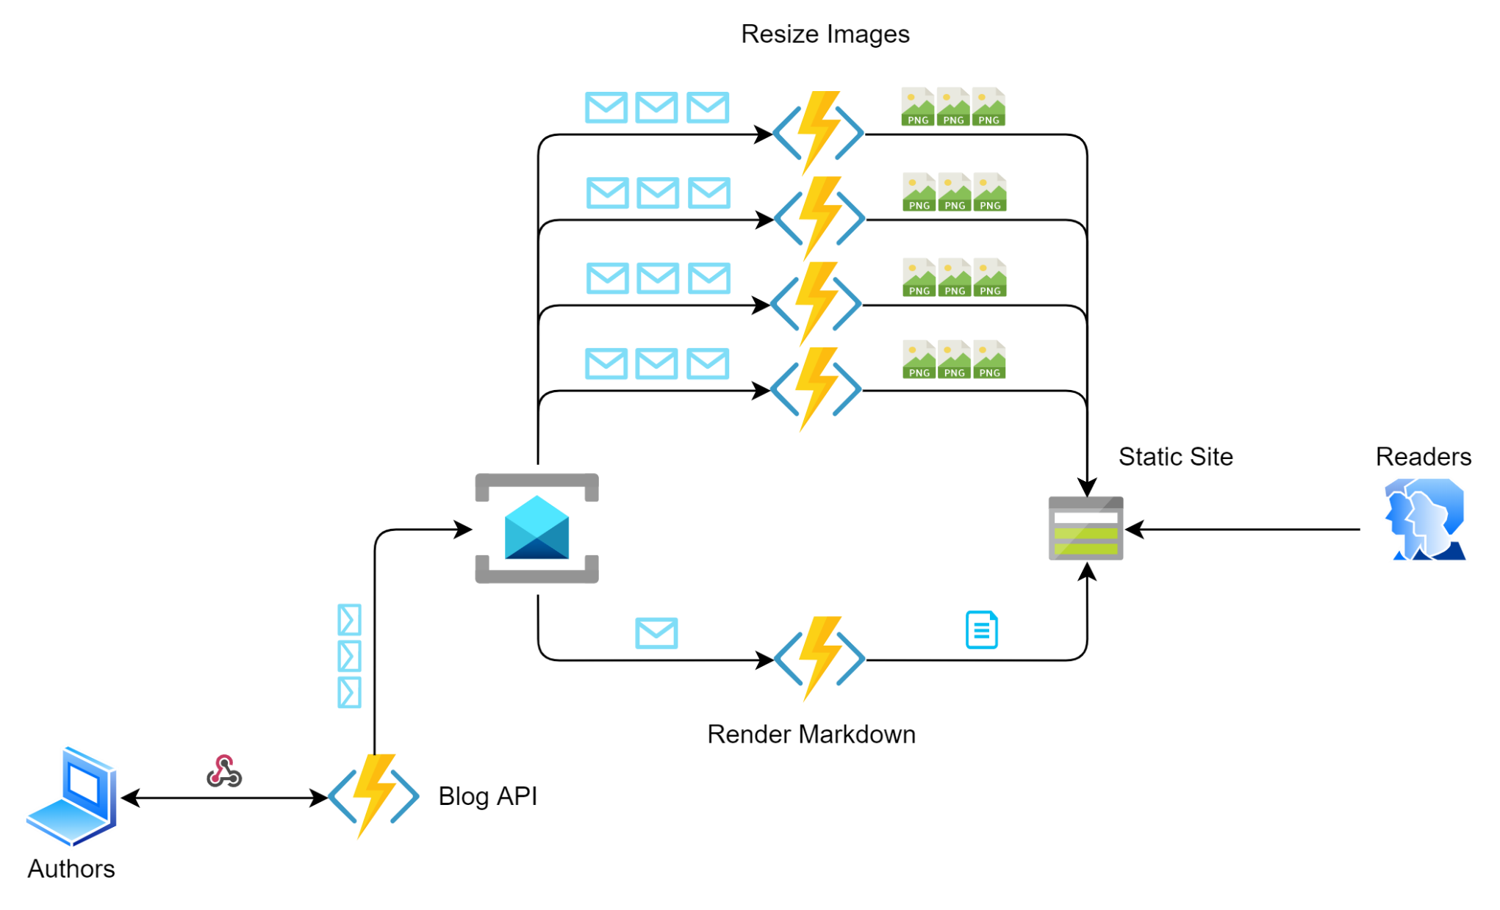
A Serverless app + ISP
Notes:
ISP – smaller apps, scales faster
We will talk about scaling a bit later

Slide 52
Clean Code Principles
DIP – Dependency Inversion Principle
Code towards the interface
Notes:
DIP – Depend on abstractions, not on concrete implementations – always code towards the interface. High level classes should not depend on low level classes.
The Dependency Inversion Principle (DIP) states that high level modules should not depend on low level modules; both should depend on abstractions. Abstractions should not depend on details. Dependency Injection
Azure Functions now has Dependency Injection Framework

Slide 53
A Serverless app + DIP
using Microsoft.Azure.Functions.Extensions.DependencyInjection;
using Microsoft.Extensions.DependencyInjection;
[assembly: FunctionsStartup(typeof(DependencyInjectionDemo.Startup))]
namespace DependencyInjectionDemo
{
public class Startup : FunctionsStartup
{
public override void Configure(IFunctionsHostBuilder builder)
{
builder.Services
.AddSingleton<IImageResizer, Lancoz3ImageResizer>();
}
}
}

Slide 54
A Serverless app + DIP
public class ServiceBusReceiver
{
private readonly IMessageReader _messageReader;
private readonly IMediator _mediator;
public ServiceBusReceiver(IMessageReader messageReader, IMediator mediator)
{
_messageReader = messageReader;
_mediator = mediator;
}
[FunctionName(nameof(ServiceBusReceiver))]
public async Task ServiceBusReceiver(
[ServiceBusTrigger(
TopicName = "%ServiceBusTopic%",
SubscriptionName = "%ServiceBusSubscription%",
Connection = "ServiceBusConnectionString")] string messageBody,
ILogger log, CancellationToken ct)
{
if (_messageReader.ReadMessage(messageBody) is IRequest message)
{
await _mediator.Send(message, ct);
}
}
}

Slide 55
A Serverless app + DIP
public class ResizeImageHandler : AsyncRequestHandler<ImageUploaded, Stream>
{
private readonly ILogger<ResizeImageHandler> _logger;
private readonly BlogConfig _config;
private readonly IImageResizer _resizer;
private readonly IImageDownloader downloader;
public ResizeImageHandler(
ILogger<ResizeImageHandler> logger,
BlogConfig config,
IImageResizer resizer,
IImageDownloader downloader)
{
_logger = logger;
_config = config;
_resizer = resizer;
_downloader = downloader;
}
protected override async Task<Stream> Handle(ImageUploaded request, CancellationToken ct)
{
var originalImageStream = await _downloader.Download(request.OriginalImageUrl, ct);
var resizedImageStream = await _resizer.Resize(originalImageStream, _config.MaxImageSize, ct);
return resizedImageStream;
}
}

Slide 56

Serverless + SOLID Principles
SRP – Single Responsibility Principle
OCP – Open/Closed Principle
LSP – Liskov Substitution Principle
ISP – Interface Segregation Principle
DIP – Dependency Inversion Principle

Slide 57
Clean Code & SOLID
SOLID & Serverless
Agenda
Resiliency
Scalability
Wrap Up!
Notes:
Photo by Artem Kniaz on Unsplash
Photo by John Thoresen on Unsplash

Slide 58

Resiliency
Don’t lose any operations
Resume operations ASAP
Provide Highly Available service

Slide 59
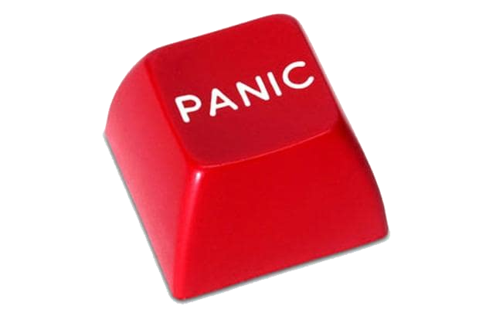
When to panic?
Natural disasters
Someone accidentally restarted a service (it happens!)
Deployments take services offline
Transient errors
Notes:
Floods, fires, lightning strikes.. Solar flares…
Transient errors – reconfiguration events, or run out of connections, firewall rules, ssl cert expiring, excess load and switching to better load balanced services…

Slide 60
Resiliency
Notes:
Very scaled down version of the full picture … <still a few pieces missing> to complete a whole blog engine…
Just to show the event flow… for now

Slide 61

Resiliency – How?
Use Async Messaging
HTTP request timeouts suck – operation is lost
Messages are persisted over outage periods
Reduces coupling
High-availability patterns/services
Deploy to multiple regions
Outbox Pattern
Retry-patterns
Notes:
Use Async Messaging instead of HTTP Requests
Messages are persisted over outage periods
Resume operations when consumer is healed
Don’t need to be too concerned about service discovery, or maintaining a lot of endpoint configs

Slide 62
Resiliency
Notes:
SRP – Single Responsibility
Only one reason to change…
Bad example: Resizeing Images and Rendering Markdown, and calculating reading time…
Good example: split into separate apps, each with their own responsibility
In terms of system design, the benefits are that Resize Images, can scale independently from all the other apps… if it breaks… it doesn’t affect the other apps.

Slide 63
Resiliency
Notes:
SRP – Single Responsibility
Only one reason to change…
Bad example: Resizeing Images and Rendering Markdown, and calculating reading time…
Good example: split into separate apps, each with their own responsibility
In terms of system design, the benefits are that Resize Images, can scale independently from all the other apps… if it breaks… it doesn’t affect the other apps.

Slide 64
Resiliency
Notes:
SRP – Single Responsibility
Only one reason to change…
Bad example: Resizeing Images and Rendering Markdown, and calculating reading time…
Good example: split into separate apps, each with their own responsibility
In terms of system design, the benefits are that Resize Images, can scale independently from all the other apps… if it breaks… it doesn’t affect the other apps.

Slide 65
Resiliency
Notes:
SRP – Single Responsibility
Only one reason to change…
Bad example: Resizeing Images and Rendering Markdown, and calculating reading time…
Good example: split into separate apps, each with their own responsibility
In terms of system design, the benefits are that Resize Images, can scale independently from all the other apps… if it breaks… it doesn’t affect the other apps.

Slide 66
Resiliency
Notes:
SRP – Single Responsibility
Only one reason to change…
Bad example: Resizeing Images and Rendering Markdown, and calculating reading time…
Good example: split into separate apps, each with their own responsibility
In terms of system design, the benefits are that Resize Images, can scale independently from all the other apps… if it breaks… it doesn’t affect the other apps.

Slide 67
Resiliency
Notes:
SRP – Single Responsibility
Only one reason to change…
Bad example: Resizeing Images and Rendering Markdown, and calculating reading time…
Good example: split into separate apps, each with their own responsibility
In terms of system design, the benefits are that Resize Images, can scale independently from all the other apps… if it breaks… it doesn’t affect the other apps.

Slide 68
Service Bus is Awesome!
What can go wrong?

Slide 69
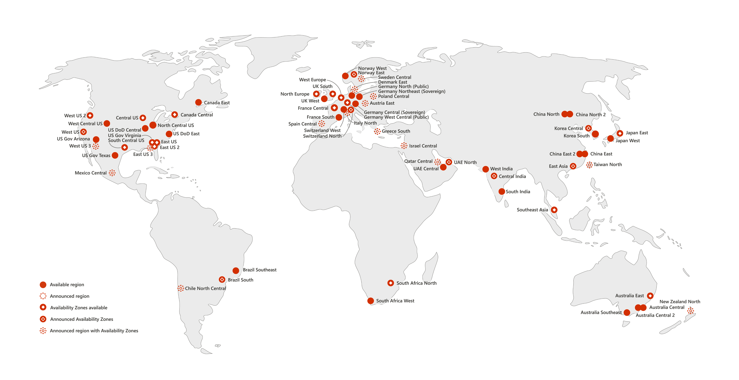

Slide 70
Service Bus - High Availability
2x ServiceBus instances in 2x regions
Active-Active replication
Send messages to both ServiceBus instances
Idempotent/De-duplicate messages at receiving end

Slide 71
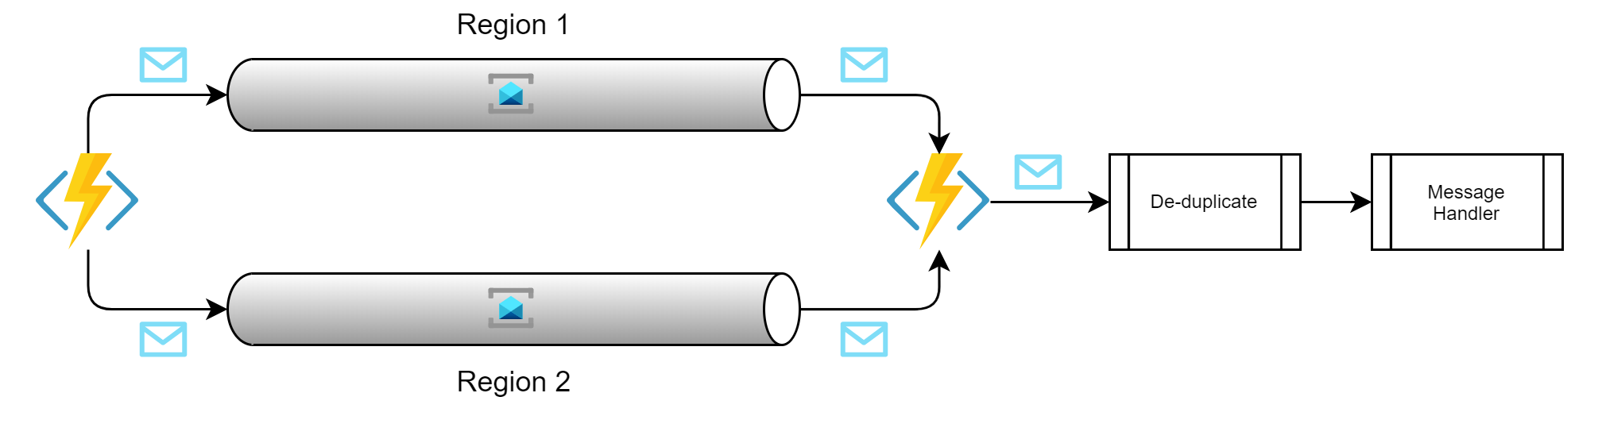
SB Active-Active replication
Active
Sender
Listener
Active
Notes:
https://docs.microsoft.com/en-us/azure/azure-functions/functions-geo-disaster-recovery

Slide 72
Service Bus - High Availability
Active-Passive replication (Recommended)
No need for de-duplicate logic
Send to Active
Fail-over to Passive

Slide 73
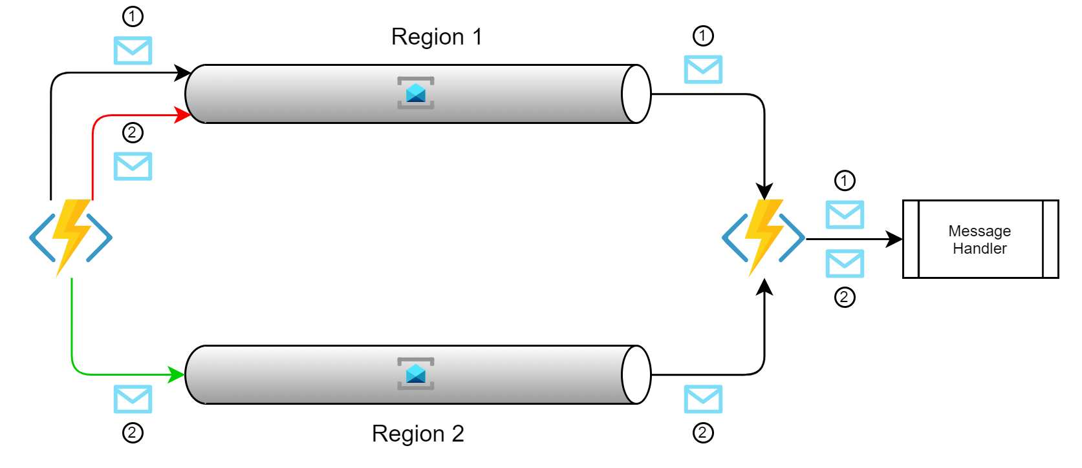
SB Active-Passive replication
Active
Sender
Listener
Passive
Notes:
https://docs.microsoft.com/en-us/azure/azure-functions/functions-geo-disaster-recovery

Slide 74
Functions - High Availability
2x Function instances in 2x regions
Active-Passive
Send to active, fail over to passive
Extra engineering required
Active-Active (Recommended)
Send requests to both instances ☹
Use Azure Front-door for HTTPS functions
Notes:
https://docs.microsoft.com/en-us/azure/azure-functions/functions-geo-disaster-recovery

Slide 75
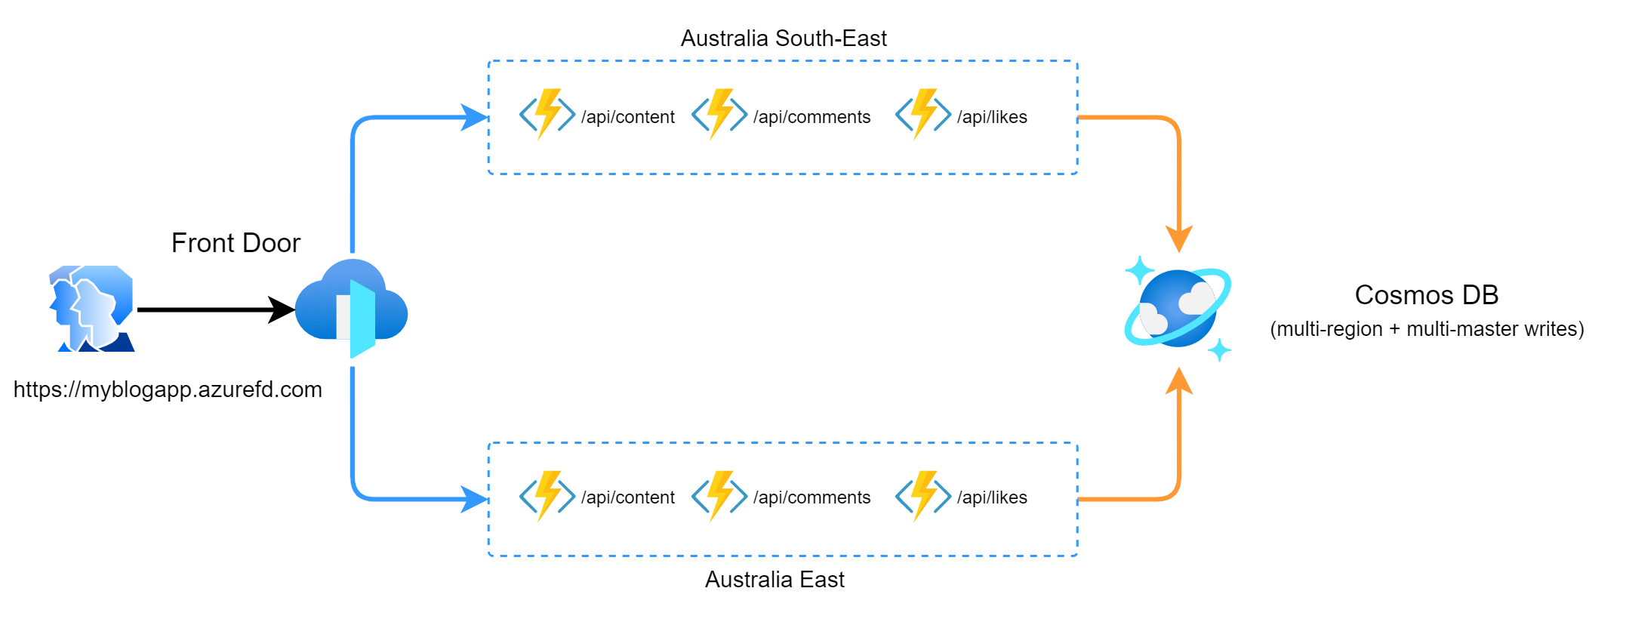
Functions - Active-Active
Notes:
https://docs.microsoft.com/en-us/azure/azure-functions/functions-geo-disaster-recovery

Slide 76
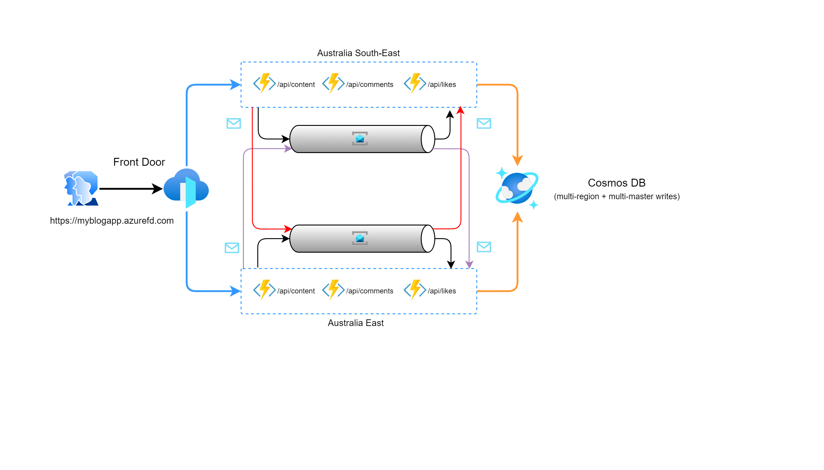
Functions Active-Active + Service Bus Active-Passive
Notes:
https://docs.microsoft.com/en-us/azure/azure-functions/functions-geo-disaster-recovery

Slide 77
Service Bus Messaging
Base Message – include all the basics
Listen via ServiceBusTrigger
Sending with TopicClient
Check out all the code: https://github.com/EnterpriseBusWorkshop/MagicBus
Notes:
ServiceBusTrigger sets up the listener to topic+subscription
Implement IMessageReader and IMessageSender – so simple!
IMessageReader can deserialize all message types – using MessageBase
IMessageSender can be injected anywhere to send Messages

Slide 78
Service Bus Message Sender
public class ServiceBusMessageSender : IMessageSender
{
private readonly ServiceBusTopicConnectionDetails _config;
public ServiceBusMessageSender(ServiceBusTopicConnectionDetails config)
{
_config = config;
}
public async Task SendMessage(MessageBase message)
{
var topicClient = new TopicClient(_config.ServiceBusConnectionString, _config.TopicName);
var busMessage = new Message(Encoding.UTF8.GetBytes(JsonConvert.SerializeObject(message)))
{
Label = message.GetType().Name,
ContentType = "application/json",
CorrelationId = message.CorrelationId
};
await topicClient.SendAsync(busMessage);
await topicClient.CloseAsync();
}
public async Task SendException(Exception ex, MessageBase sourceMessage)
{
var exceptionMessage = new ExceptionMessage(sourceMessage, ex);
await SendMessage(exceptionMessage);
}
}

Slide 79
Service Bus Message Reader
public class MessageReader : IMessageReader
{
public MessageBase ReadMessage(string messageBody)
{
return JsonConvert
.DeserializeObject(messageBody, GetMessageType(messageBody)) as MessageBase;
}
public Type GetMessageType(string messageBody)
{
JObject j = JObject.Parse(messageBody);
var typeName = j["MessageType"].ToString();
return Type.GetType(typeName);
}
public T ReadMessage<T>(string messageBody) where T : MessageBase
{
return JsonConvert.DeserializeObject<T>(messageBody);
}
}

Slide 80
Service Bus Trigger (Listener)
public class ServiceBusReceiver
{
private readonly IMessageReader _messageReader;
private readonly IMediator _mediator;
public ServiceBusReceiver(IMessageReader messageReader, IMediator mediator)
{
_messageReader = messageReader;
_mediator = mediator;
}
[FunctionName(nameof(ServiceBusReceiver))]
public async Task ServiceBusReceiver(
[ServiceBusTrigger(
TopicName = "%ServiceBusTopic%",
SubscriptionName = "%ServiceBusSubscription%",
Connection = "ServiceBusConnectionString")] string messageBody,
ILogger log, CancellationToken ct)
{
if (_messageReader.ReadMessage(messageBody) is IRequest message)
{
try
{
await _mediator.Send(message, ct);
}
catch (ValidationException)
{
// swallow validation exceptions - validation pipeline already sent exception on the bus - just log it here
log.LogWarning("message failed validation");
}
}
}
}

Slide 81
Service Bus Message Handler
public class ConvertMarkdownHandler : AsyncRequestHandler<MarkdownUploaded>
{
private readonly ILogger<ConvertMarkdownHandler> _logger;
private readonly BlogConfig _config;
public ConvertMarkdownHandler(ILogger<ConvertMarkdownHandler> logger, BlogConfig config)
{
_logger = logger;
_config = config;
}
protected override async Task Handle(MarkdownUploaded request, CancellationToken cancellationToken)
{
try
{
/* logic goes here */
/* convert Markdown text into HTML */
/* save to static site */
/* ... */
}
catch (BlogException e)
{
_logger.LogError(e, “Couldn’t convert markdown text to html ☹");
throw;
}
}
}

Slide 82
Agenda
Clean Code & SOLID
SOLID & Serverless
Resiliency
Scalability
Wrap Up!
Notes:
Photo by Artem Kniaz on Unsplash
Photo by John Thoresen on Unsplash

Slide 83
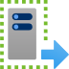
Scalability
Max scale depends on:
Consumption Plan (200 instances)
Premium Plan (100 instances)
Dedicated AppService Plan (10-20 instances)
Kubernetes (it depends™)
Notes:
Windows – 100
Linux – 20
To get around the instance limits, you can deploy multiple instances in each region and use frontdoor route rules to point to the extra instances
Premium ~= 800x fully scaled out consumption plan… $$$

Slide 84
Scalability
Keep your apps small
Keep the operations short (don’t block for a long time)
Use separate storage accounts
One for function triggers/bindings
One for application results (images, pdf, csv …)

Slide 85
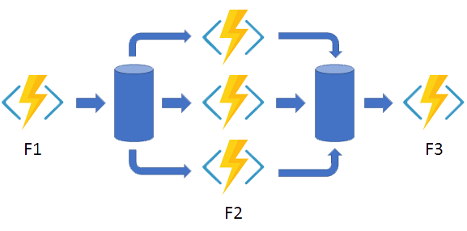
Scalability
Azure Durable Functions for extra oompf!
Fan-Out/Fan-In

Slide 86
Scalability
Turn HTTP requests into ServiceBus messages ASAP!
Use multiple ServiceBus Topics
queues only allow 1 listener/consumer
topic allow for multiple listeners/consumers
allows more functions to run in parallel
Use the “Manage” rights on ServiceBus access policies
Allows ServiceBusTrigger to inspect queue length and scale proactively/correctly

Slide 87
Scalability
Function App
FILTER
SUBSCRIPTION
Function App
TOPIC
FILTER
SUBSCRIPTION
Function App
Function App

Slide 88
Scalability
Send results to High-Throughput storage
Cosmos DB
EventHub
Premium Storage
Limit connections
reuse clients (as singletons)
connection pooling

Slide 89
Agenda
Clean Code & SOLID
SOLID & Serverless
Resiliency
Scalability
Wrap Up!
Notes:
Photo by Artem Kniaz on Unsplash
Photo by John Thoresen on Unsplash

Slide 90
Summary
Use Serverless over Traditional
SOLID makes Serverless Architecture clean & simple
Use Async Messaging over HTTP requests improves resiliency, scalability and decreases coupling
Serverless High Availability is easy!
Notes:
SOLID Serverless =
+ Easy to understand
+ Easy to maintain and extend
+ Testable
Async Messaging

Slide 91
Go build Rock SOLID Serverless Apps!!

Slide 92


Thank you! www.ssw.com.au Sydney | Melbourne | Brisbane | Newcastle | China
@William_DotNet
azuregems.io
/william-liebenberg
williamliebenberg@ssw.com.au

